Slide 1





EDGE: BU-CSE Digital Skills Training
University of Barishal
Presentation Topic: Findings From My Research
Presented By:
Md. Rajon Hossain
Department of Bangla

Slide 2
Outline
Introduction
Review of Literature
Synthesis
Results and discussion
Applications
Conclusion

Slide 3
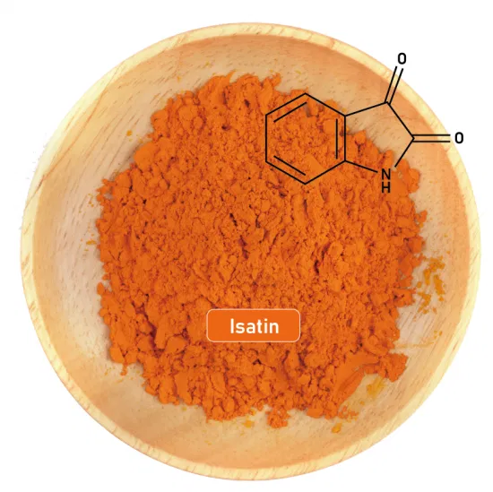
Introduction
Isatin is my starting material.
It has many pharmaceutical properties.

Slide 4
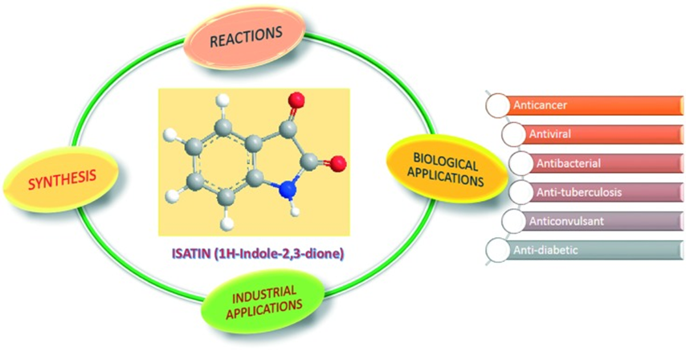
Review of Literature
Global research endeavors continue to explore the pharmacological activities and synthetic potential of isatin derivatives.

Slide 5
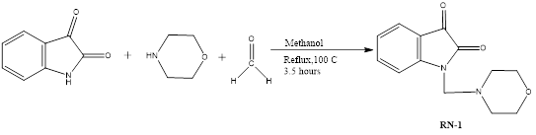
Synthesis of My Desired Product

Slide 6
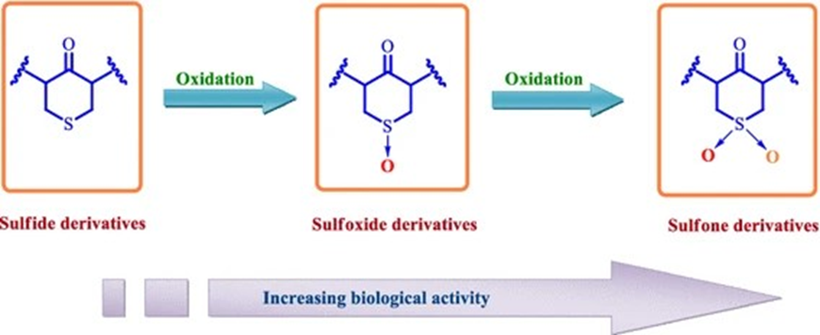
Application
The compound RN-1 or 1-(morpholinomethyl)indoline-2,3-dione (RN-1) may exhibits potential applications in medicinal chemistry due to its unique structure.

Slide 7

Any Question???

